Slide 1
Microeconomics for Business
Chapter 6 – Monopolistic Competition
Elasticity and Lerner Index

Slide 2
Think of a memorable ad

Slide 3

How the world really works
Market Structure

Slide 4
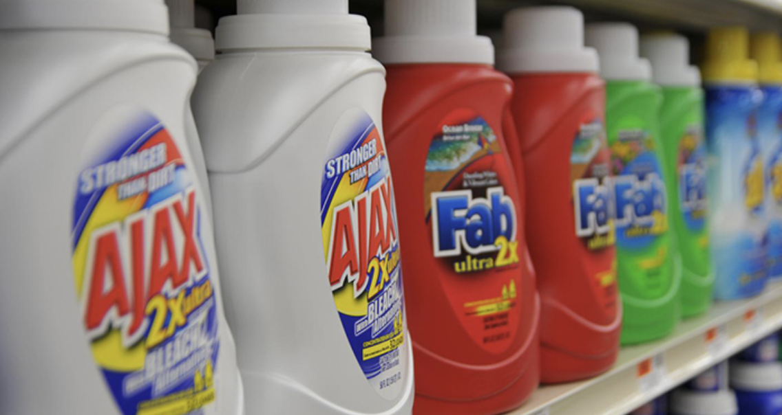

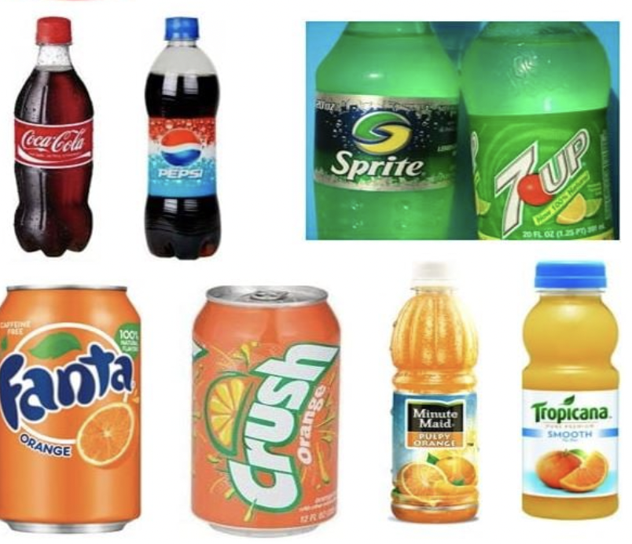
Market Structure

Slide 5
Perfect Competition Assumptions | How firms try to beat it | Economic Term
All goods the same | Differentiate your product | Monopolistic Competition
 | Patent/Copyright | Monopoly
Many buyers and sellers | Horizontal/Vertical integration Price Wars | Monopoly Game Theory
Easy Entry/Exit | Erect barriers to entry (regulatory capture) | Monopoly
Everyone knows price and good quality | Come up with ways to offer different prices to different consumers | Price Discrimination

Slide 6
The market spectrum
Many firms
One firm
Present competition
Easy entry
Many barriers to entry
future competition
outside competition
No substitutes
Many substitutes

Slide 7
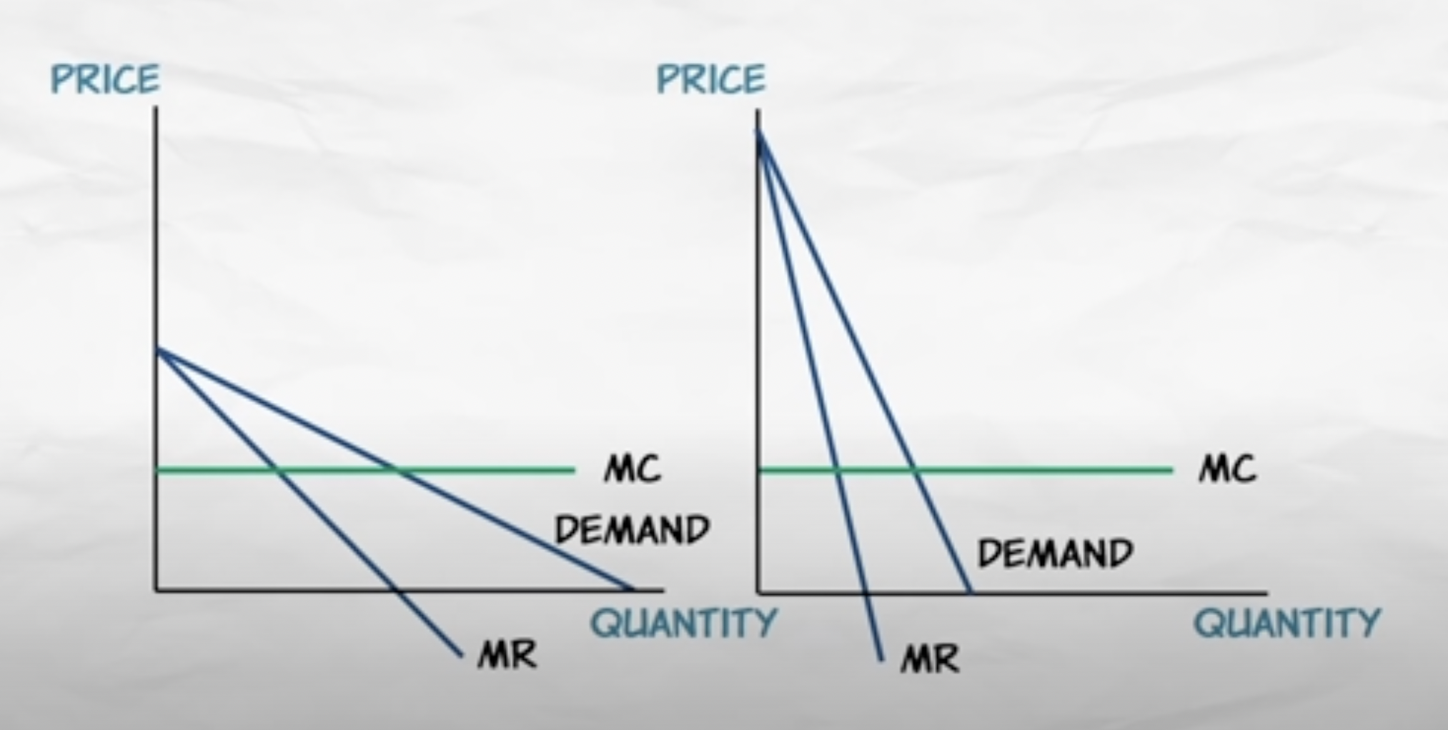
The Mark-up
Market Structure

Slide 8
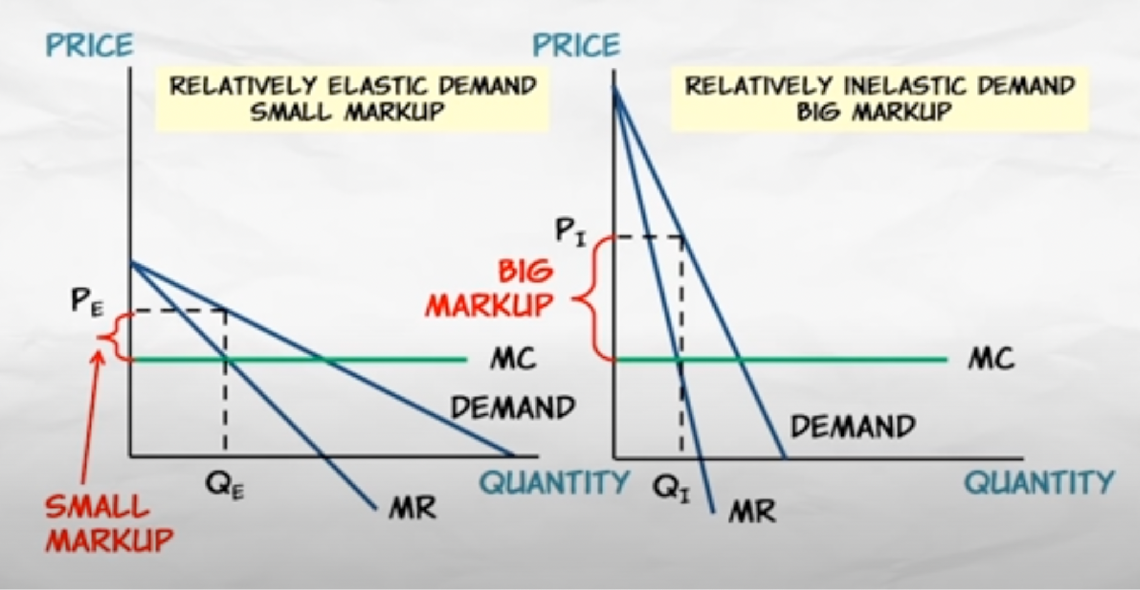
The Mark-up
Market Structure

Slide 9
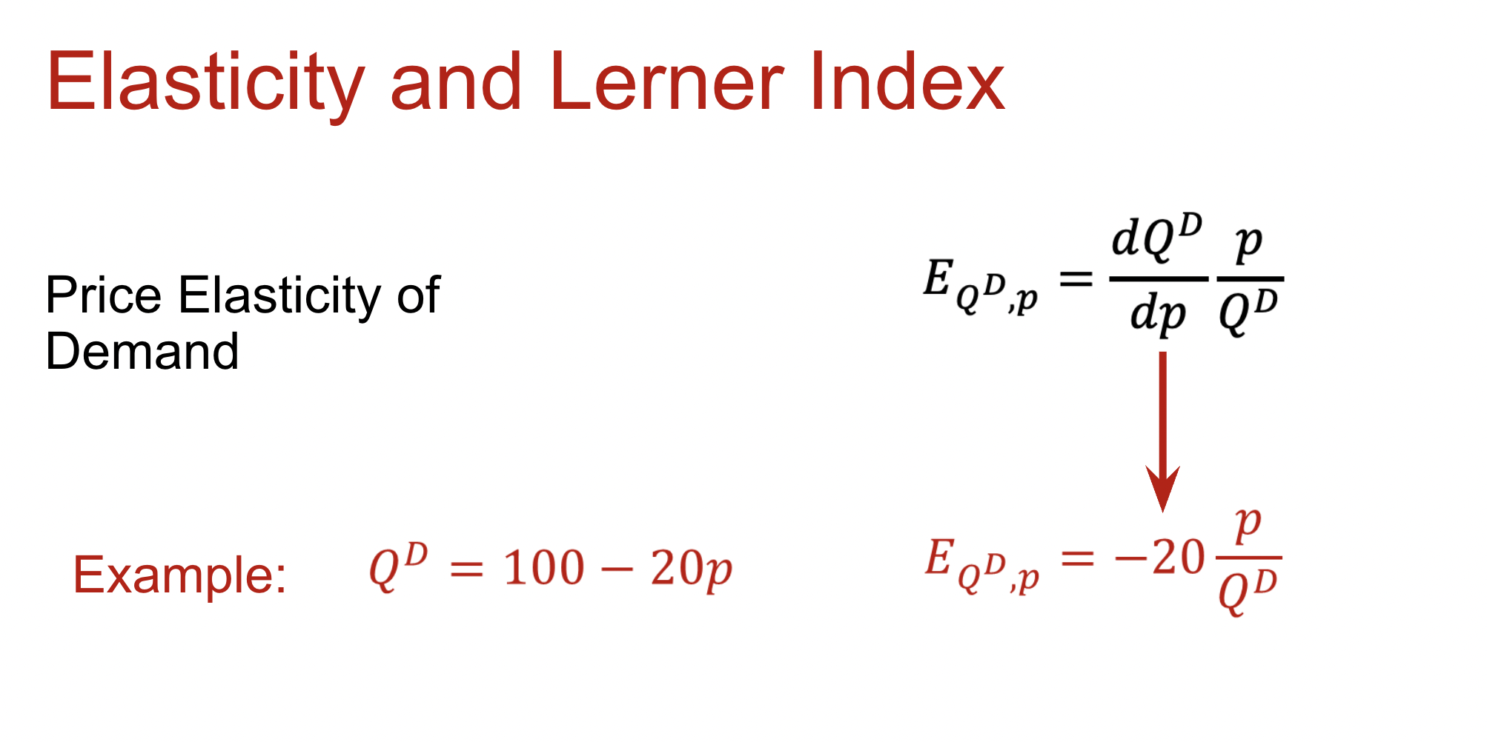

Slide 10
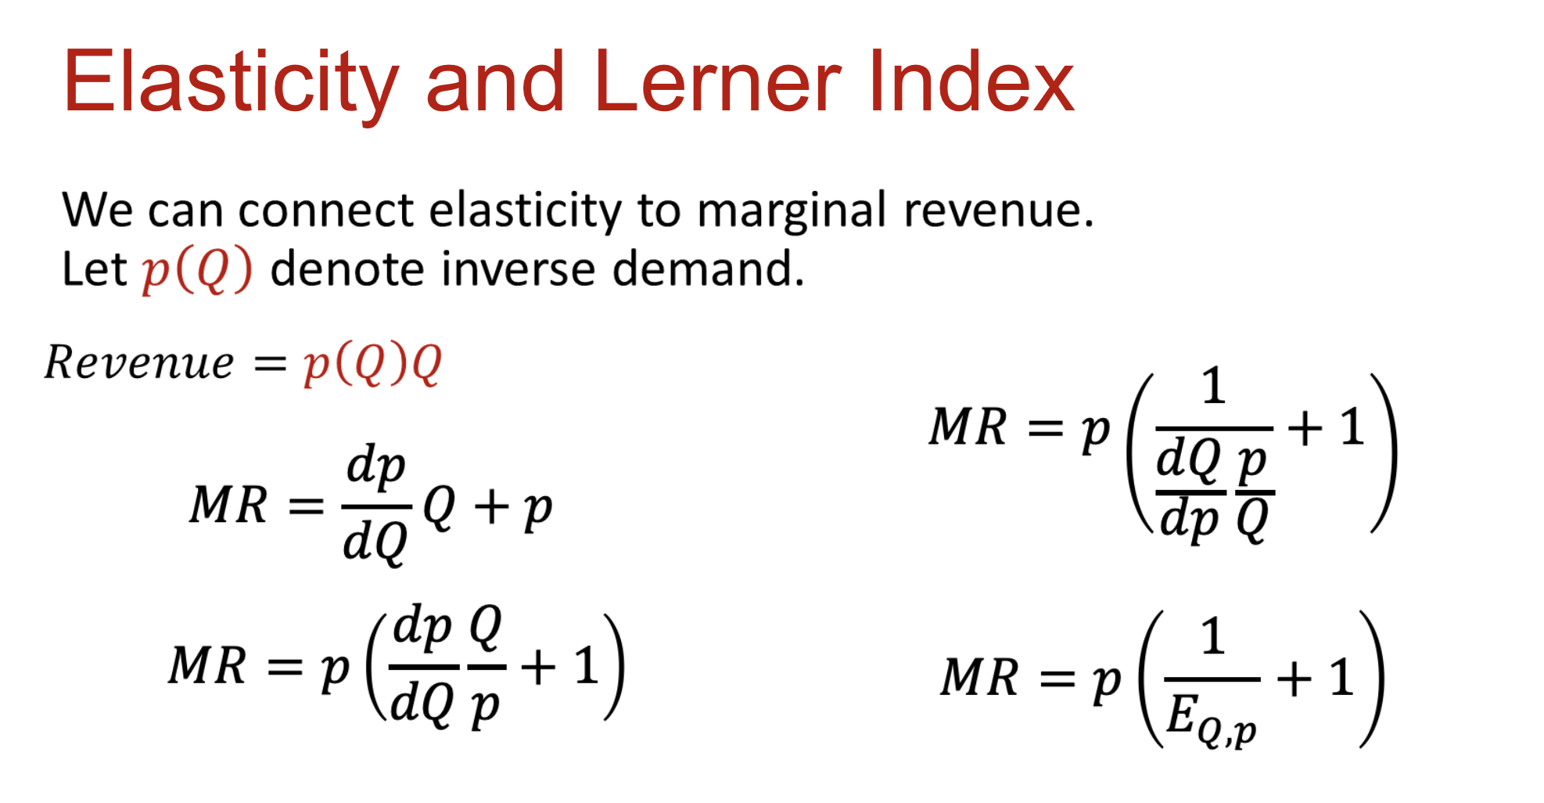

Slide 11
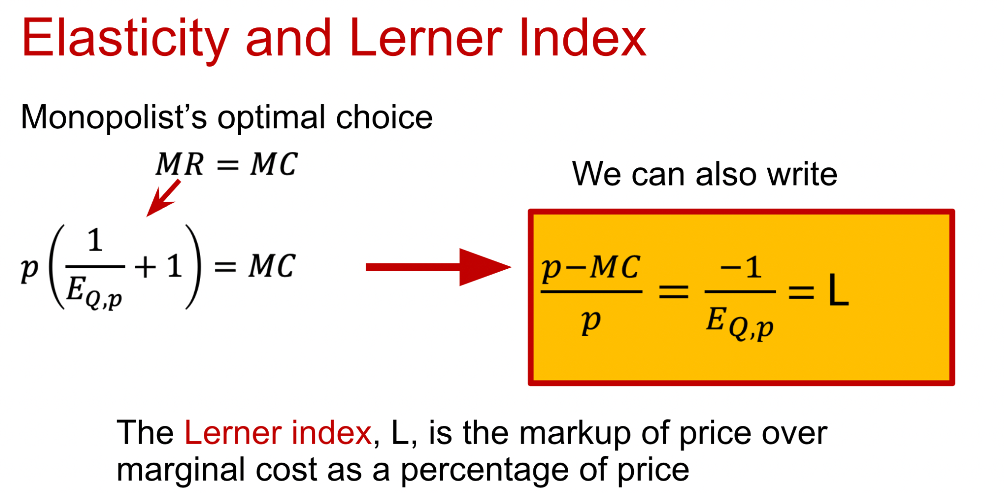

Slide 12
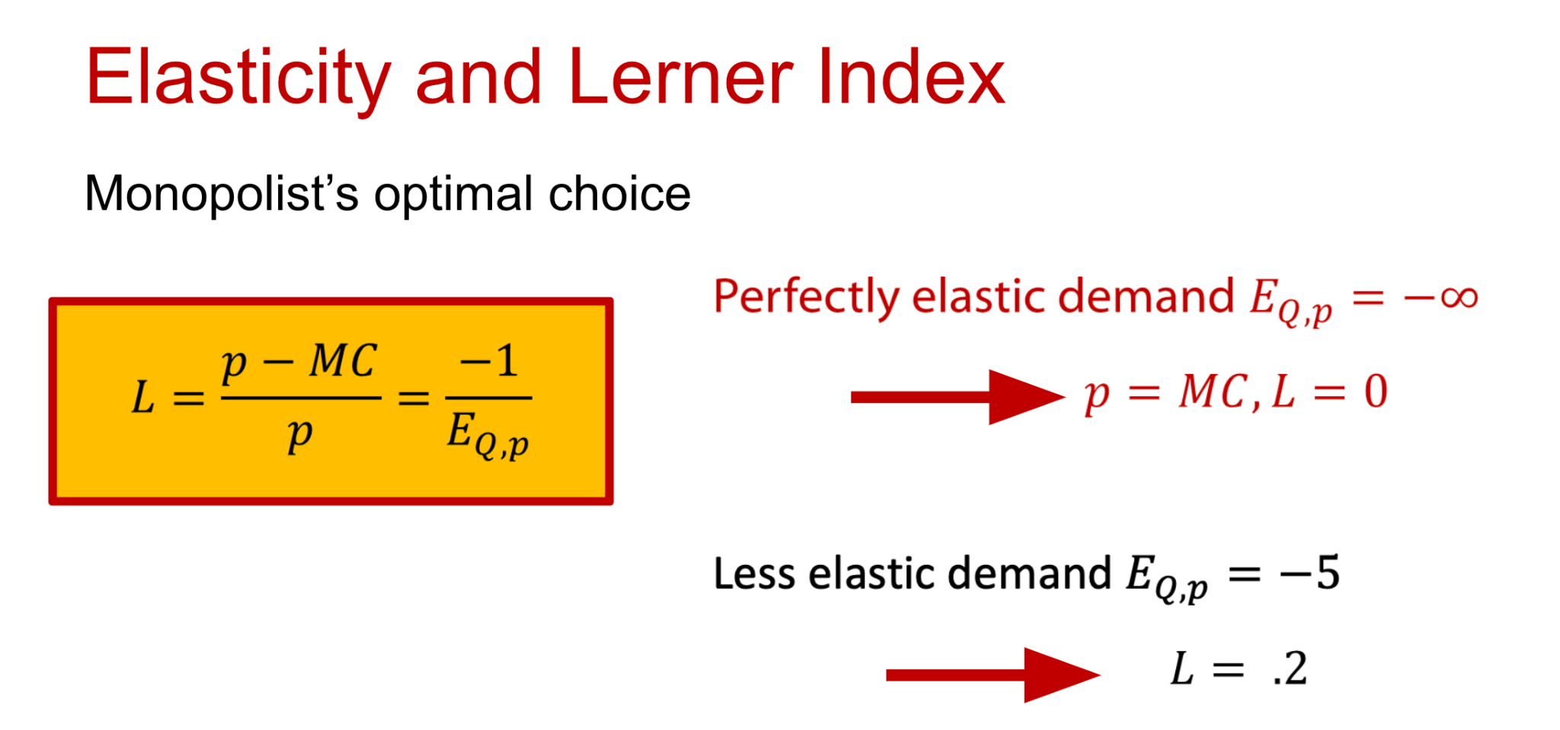

Slide 13
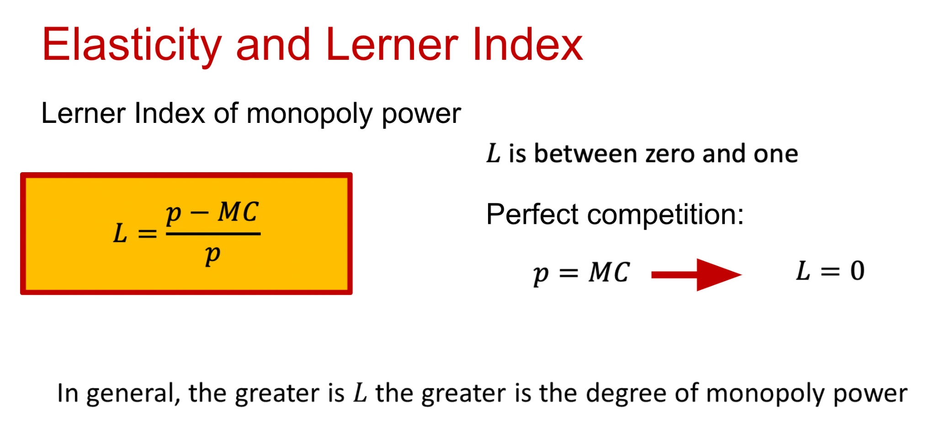

Slide 14
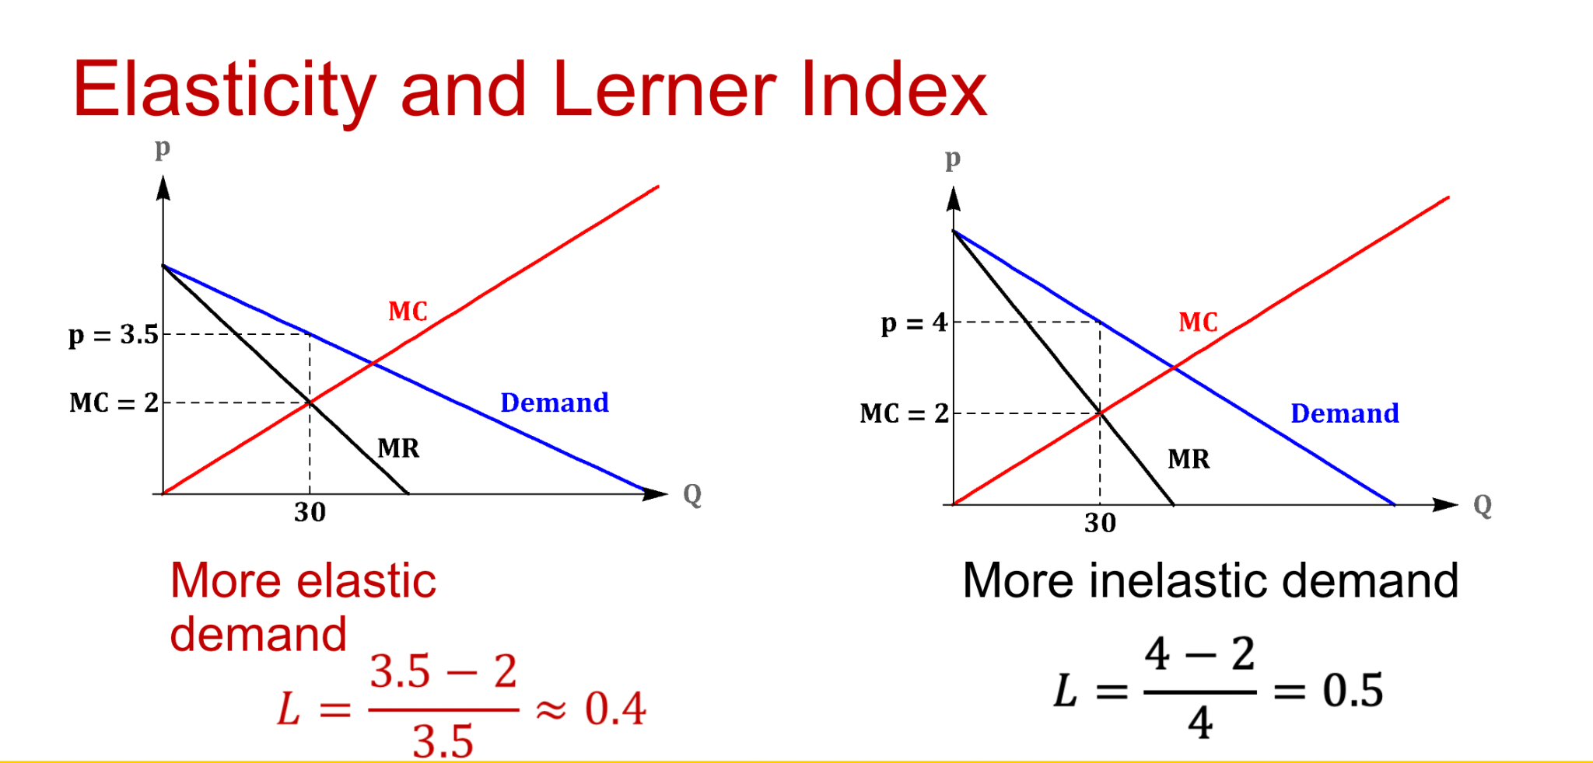

Slide 15

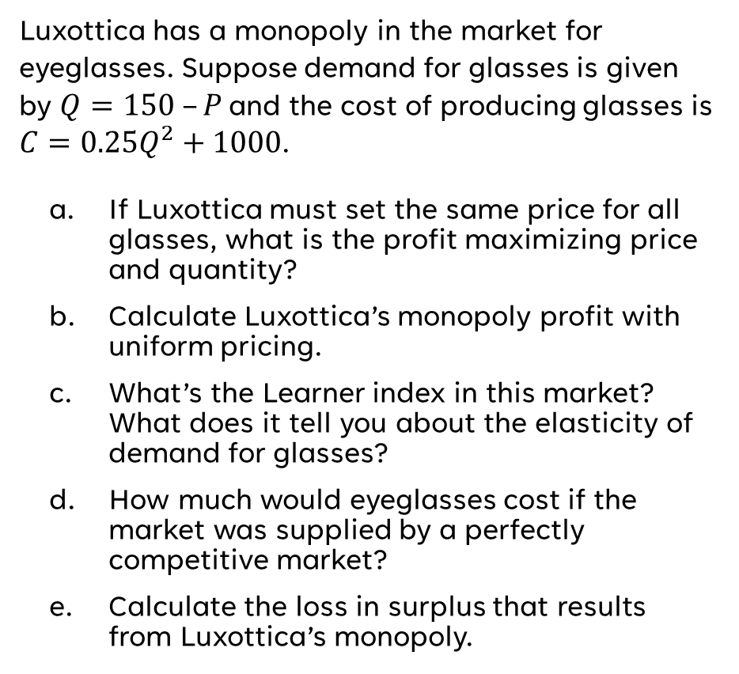
Monopoly
(Group Work)

Slide 16
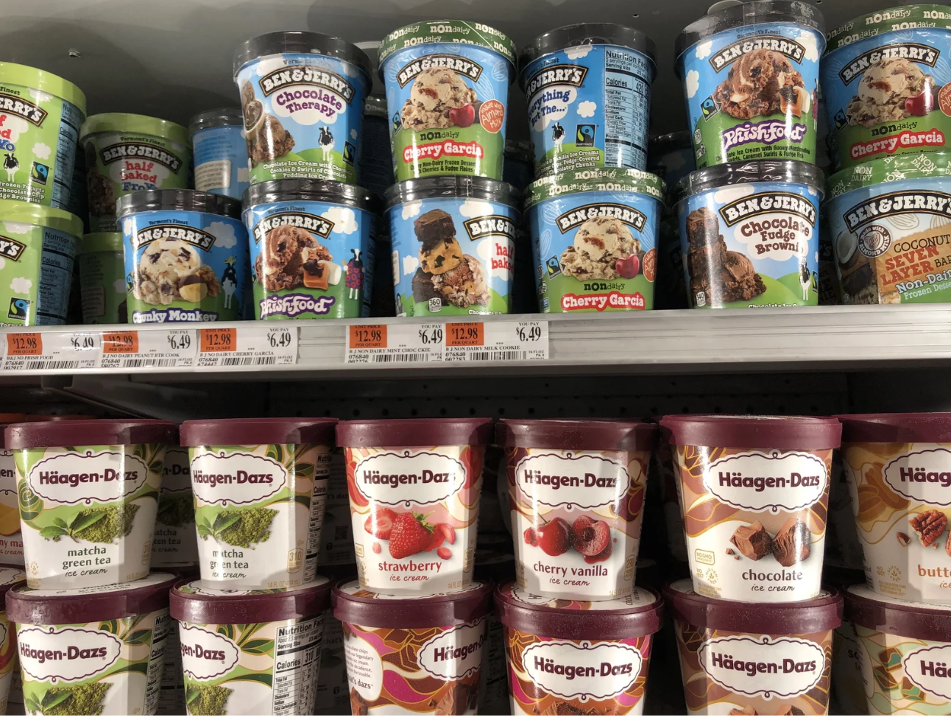
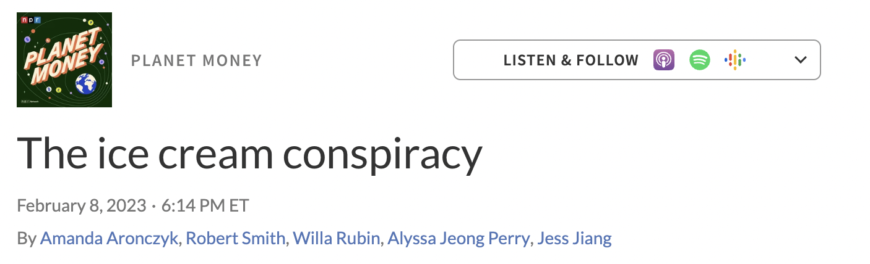
Examples?
Market Structure

